Slide 1
Noise, Information Theory, and Entropy
Sujoy Mukherjee

Slide 2
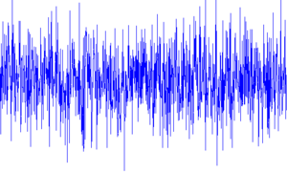
Why study noise?
It’s present in all systems of interest, and we have to deal with it
By knowing its characteristics, we can fight it better
Create models to evaluate analytically

Slide 3
Communication system abstraction
Information
source
Encoder
Modulator
Sender side
Channel
Receiver side
Decoder
Demodulator
Output signal

Slide 4
The additive noise channel
Transmitted signal s(t) is corrupted by noise source n(t), and the resulting received signal is r(t)
Noise could result form many sources, including electronic components and transmission interference
s(t)
+
r(t)
n(t)

Slide 5
Random processes
A random variable is the result of a single measurement
A random process is a indexed collection of random variables, or equivalently a non-deterministic signal that can be described by a probability distribution
Noise can be modeled as a random process

Slide 6
White Gaussian Noise
When an additive noise channel has a white Gaussian noise source, we call it an AWGN channel
Most frequently used model in communications
Reasons why we use this model
  It’s easy to understand and compute
  It applies to a broad class of physical channels

Slide 7
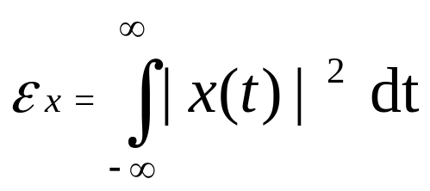
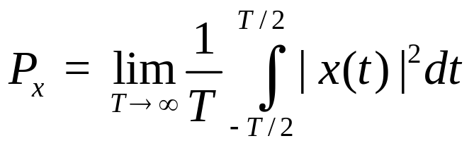
Signal energy and power
Energy is defined as
Power is defined as
Most signals are either finite energy and zero power, or infinite energy and finite power
Noise power is hard to compute in time domain
  Power of WGN is its variance σ²

Slide 8


Signal to Noise Ratio (SNR)
Defined as the ratio of signal power to the noise power corrupting the signal
Usually more practical to measure SNR on a dB scale
Obviously, want as high an SNR as possible

Slide 9

Information theory and entropy
Information theory tries to solve the problem of communicating as much data as possible over a noisy channel
Measure of data is entropy
Claude Shannon first demonstrated that reliable communication over a noisy channel is possible (jump-started digital age)

Slide 10

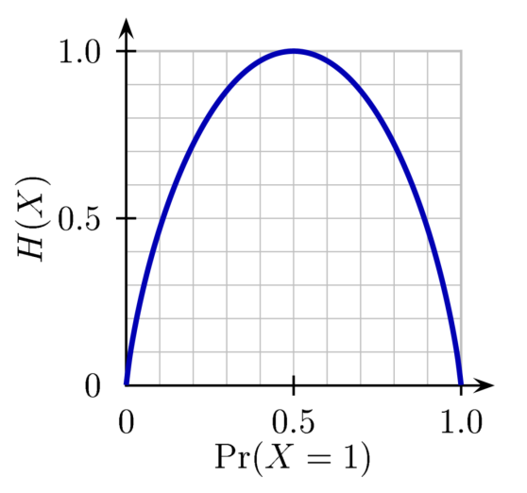

Entropy definitions
Shannon entropy
Binary entropy formula
Differential entropy

Slide 11
Properties of entropy
Can be defined as the expectation of log p(x) (ie H(X) = E[-log p(x)])
Is not a function of a variable’s values, is a function of the variable’s probabilities
Usually measured in “bits” (using logs of base 2) or “nats” (using logs of base e)
Maximized when all values are equally likely (ie uniform distribution)
Equal to 0 when only one value is possible
  Cannot be negative

Slide 12


Joint and conditional entropy
Joint entropy is the entropy of the pairing (X,Y)
Conditional entropy is the entropy of X if the value of Y was known
Relationship between the two

Slide 13
Mutual information
Mutual information is how much information about X can be obtained by observing Y

Slide 14
Mathematical model of a channel
Assume that our input to the channel is X, and the output is Y
Then the characteristics of the channel can be defined by its conditional probability distribution p(y|x)

Slide 15

Channel capacity and rate
Channel capacity is defined as the maximum possible value of the mutual information
  We choose the best f(x) to maximize C
For any rate R < C, we can transmit information with arbitrarily small probability of error

Slide 16
Coding theory
Information theory only gives us an upper bound on communication rate
Need to use coding theory to find a practical method to achieve a high rate
2 types
  Source coding - Compress source data to a smaller size
  Channel coding - Adds redundancy bits to make transmission across noisy channel more robust

Slide 17
Source-channel separation theorem
Shannon showed that when dealing with one transmitter and one receiver, we can break up source coding and channel coding into separate steps without loss of optimality
Does not apply when there are multiple transmitters and/or receivers
  Need to use network information theory principles in those cases

